Slide 1


Starting Out with Visual c sharp
Sixth Edition
Chapter 2
Processing Data
Copyright © 2023, 2017, 2014 Pearson Education, Inc. All Rights Reserved
Notes:
If this PowerPoint presentation contains mathematical equations, you may need to check that your computer has the following installed:
1) MathType Plugin
2) Math Player (free versions available)
3) NVDA Reader (free versions available)

Slide 2
Topics (1 of 2)
3.1 Reading Input with TextBox Controls
3.2 A First Look at Variables
3.3 Numeric Data Type and Variables
3.4 Performing Calculations
3.5 Inputting and Outputting Numeric Values
3.6 Formatting Numbers with the ToString Method
3.7 Simple Exception Handling
3.8 Using Named Constants

Slide 3
Topics (2 of 2)
3.9 Declaring Variables as Fields
3.10 Using the Math Class
3.11 More G U I Details
3.12 Using the Debugger to Locate Logic Errors

Slide 4
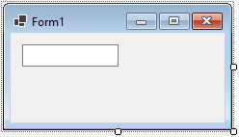
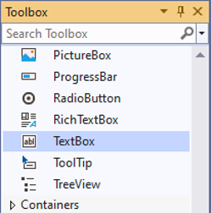
3.1 Reading Input with TextBox Control
TextBox control
  a rectangular area
  can accept keyboard input from the user
  located in the Common Control group of the Toolbox
  double click to add it to the form
  default name is textBoxn
    where n is 1, 2, 3, …

Slide 5
The Text Property
A TextBox control’s Text property stores the user inputs
Text property accepts only string values, e.g.
textBox1.Text = "Hello";
To clear the content of a TextBox control, assign an empty string("")
textBox1.Text = "";
textBox1.Text = string.Empty;
textBox1.Clear();

Slide 6
3.2 A First Look at Variables
A variable is a storage location in memory
A variable name represents the memory location
In
you must declare a variable in a program before
using it to store data
The syntax to declare variables is:
DataType VariableName;

Slide 7
Data Types
A
variable must be declared with a proper data type
The data type specifies the type of data a variable can hold
In
many data types are known as primitive data types
  they store fundamental types of data (means essential or core
  such as strings and integers
“Primitive” means basic / simple / built-in.
In C#, primitive data types are already defined by the language, not created by you.

Slide 8
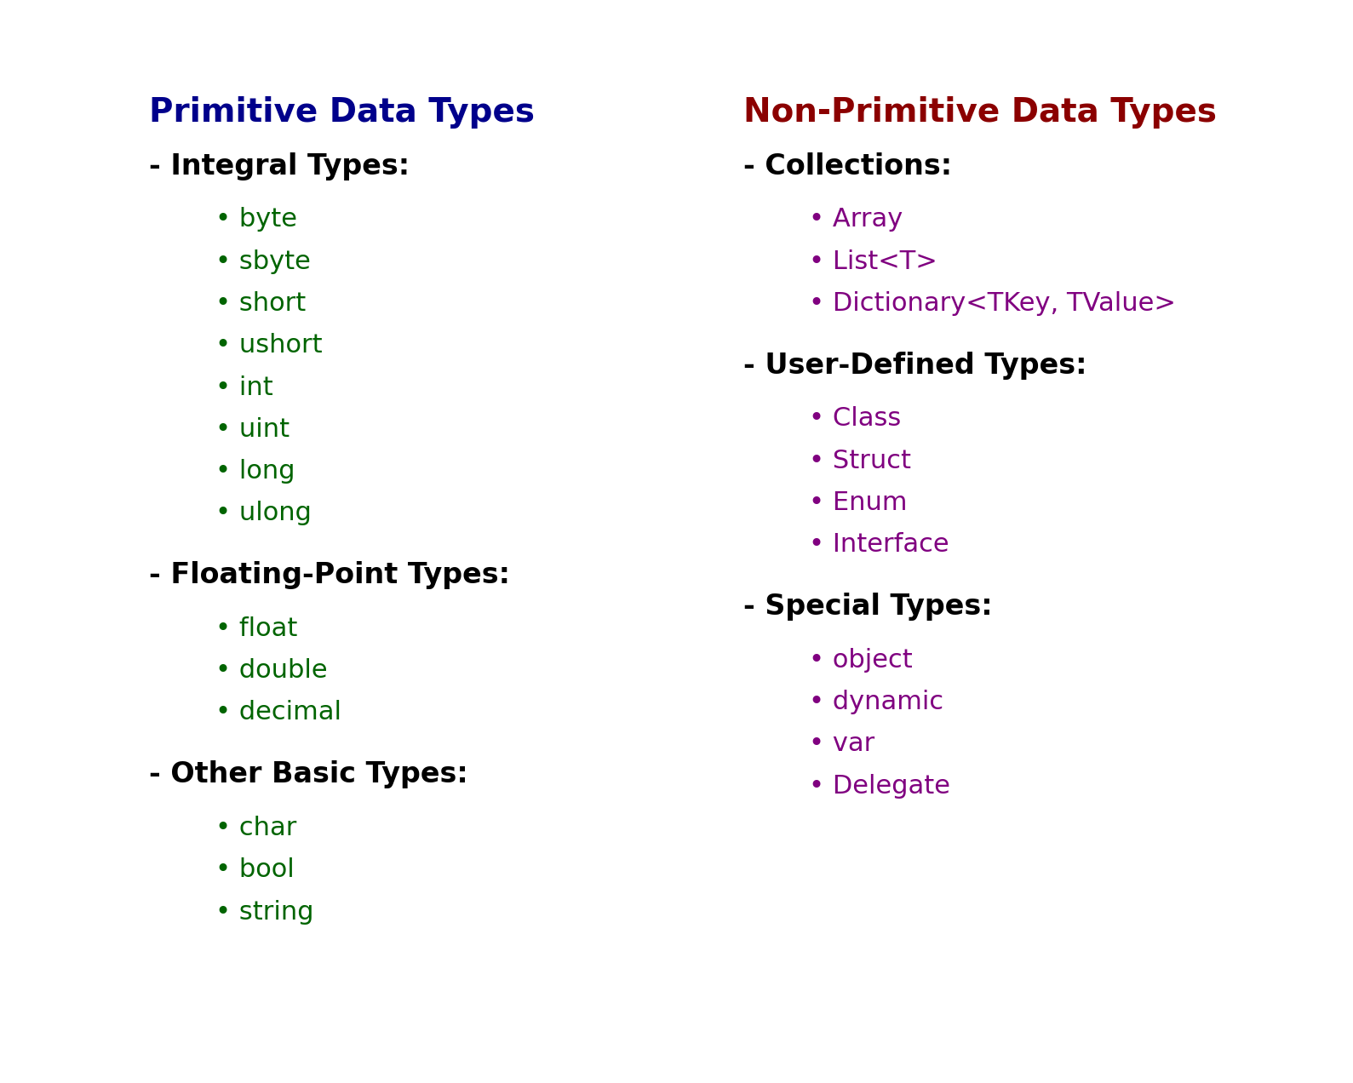

Slide 9
Variable Names
A variable name identifies a variable
Always choose a meaningful name for variables
Basic naming conventions are:
  the first character must be a letter (upper or lowercase) or an underscore (_)
  the name cannot contain spaces
  do not use
  keywords or reserved words

Slide 10
String Variables
A string is a combination of characters
A variable of the string data type can hold any combination of characters, such as names, phone numbers, and social security numbers
The value of a string variable is assigned on the right of the = operator surrounded by a pair of double quotes:
productDescription = "Jamhuuriya University";
The following assigns the productDescription string to a Label control named productLabel:
productLabel = productDescription;
You can also display a string variable in a Message Box:
MessageBox.Show(productDescription);

Slide 11
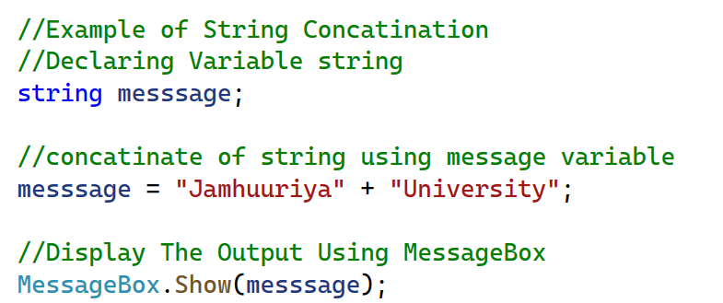
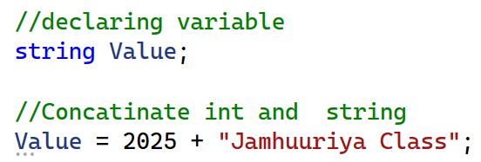
String Concatenation
Concatenation is the appending of one string to the end of another string
In
the + operator is used for concatenation
Concatenation can happen between a string and another data type
  int and string
  double and string
12 + " apples";
"Total is " + 25.75;

Slide 12
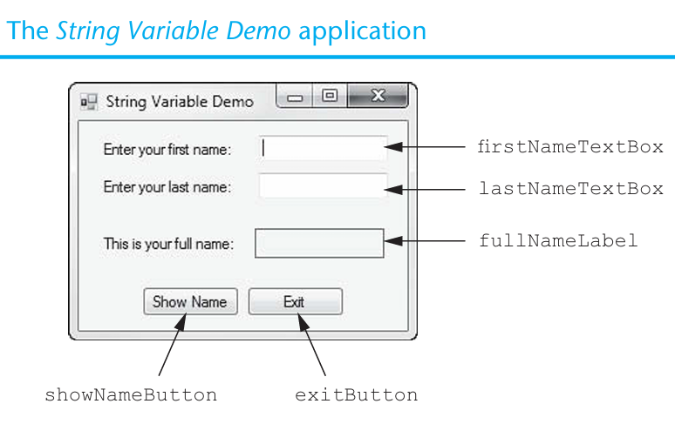
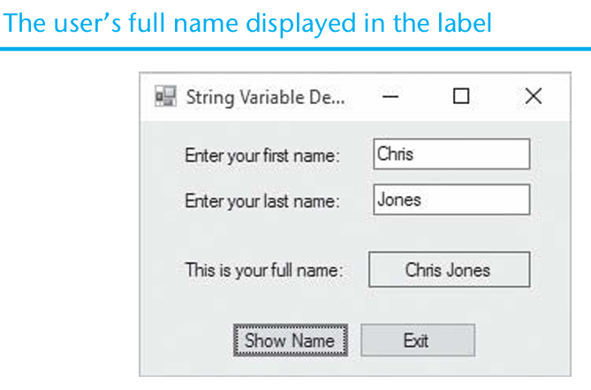
Example of string variable demo application

Slide 13
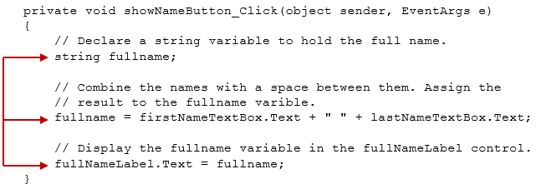
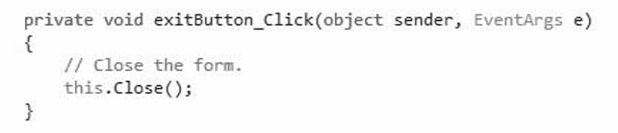
Declaring Variables Before Using Them
You can declare variables and use them later
Notes:
The code has 12 lines. The lines read as follows. Line 1, private void show Name Button underscore Click left parenthesis object sender comma Event A r g s e right parenthesis. Line 2, left brace . Line 3, indented once. forward slash forward slash Declare a string variable to hold the full name period . Line 4, indented once. string full name semicolon . Line 5. blank. Line 6, indented once. forward slash forward slash Combine the names with a space between them period Assign the. Line 7, indented once. forward slash forward slash result to the full name variable period. Line 8, indented once. fullname equals sign first Name Text Box period Text plus double quote double quote plus last Name Text Box period Text semicolon . Line 9. blank. Line 10, indented once. forward slash forward slash Display the full name variable in the full Name Label control period . Line 11, indented once. Full Name Label period Text equals sign full name semicolon. Line 12, right brace. Arrows points the line 4, line 7, and line 11 in the computer code.

Slide 14
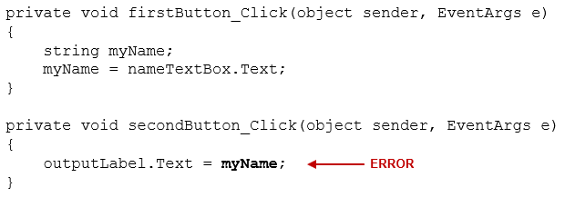
Local Variables and Scope
A local variable belongs to the method in which it was declared
Only statements inside that method can access the variable
Scope describes the part of a program in which a variable may be accessed
Lifetime of a variable is the time period during which the variable exists in memory while the program is executing
A local variable is created in memory when the method in which it is declared starts executing. When the method ends, all the method’s local variables are destroyed.
Notes:
The code has 10 lines. The lines read as follows. Line 1. private void first Button underscore Click left parenthesis object sender comma Event A r g s e right parenthesis . Line 2. left brace . Line 3, indented once. string my Name semicolon . Line 4, indented once. My Name equals sign name Text Box period Text semicolon . Line 5. right brace . Line 6. blank. Line 7. private void second Button underscore Click left parenthesis object sender comma Event A r g s e right parenthesis . Line 8. left brace . Line 9, indented once. output Label period Text equals sign my Name semicolon 4 . Line 10. right brace. Line 9 is labeled, error.

Slide 15
Duplicate Variable Names
You cannot declare two variables with the same name in the same scope.
For example, if you declare a variable named productDescription in an event handler, you cannot declare another variable with that name in the same event handler.
You can, however, have variables of the same name declared in different methods
Assignment Compatibility
You can assign a value to a variable only if the value is compatible with the variable’s data type.
Only strings are compatible with the string data type

Slide 16
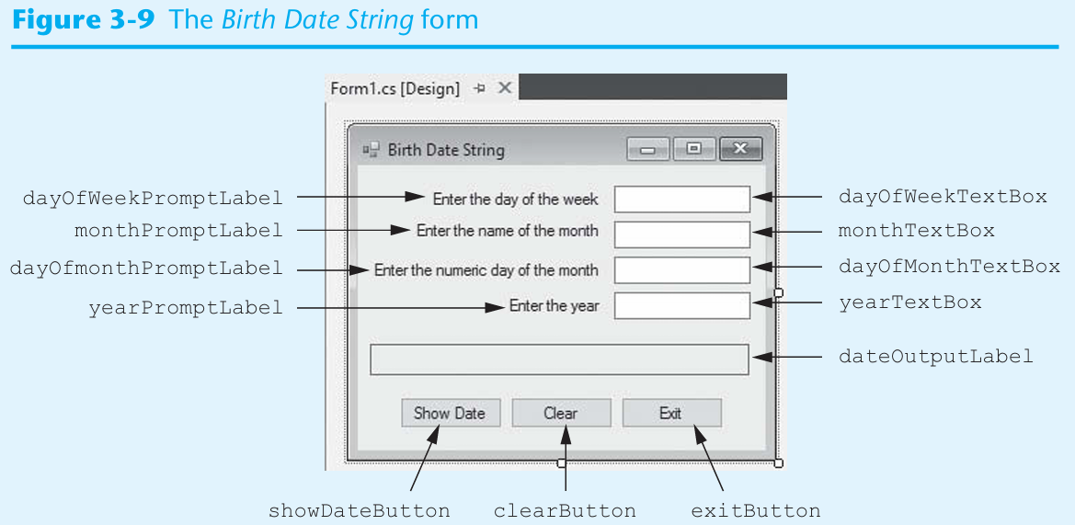
Home Assignment

Slide 17
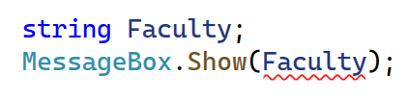
Initializing Variables
In C#, a variable must be assigned a value before it can be used. For example, look at this code:
This code declares a string variable named productDescription and then tries to display the variable’s value in a message box.
The only problem is that we have not assigned a value to the variable. When we compile the application containing this code, we will get an error message such as Use of unassigned local variable ‘productDescription’.
The C# compiler will not compile code that tries to use an unassigned variable.

Slide 18
Declaring Multiple Variables with One Statement
You can declare multiple variables of the same data type with one declaration statement. Here is an example:
string lastName, firstName, middleName;
Remember, you can break up a long statement, so it spreads across two or more lines. Sometimes you will see long variable declarations written across multiple lines, like this:
string lastName = "Khalaf",
firstName = "Mohamed",
middleName = "Abdullahi";

Slide 19
3.3 Numeric Data Types and Variables
If you need to store a number in a variable and use the number in a mathematical operation, the variable must be of a numeric data type
Commonly used
numeric data types:
  int: whole number in the range of
  to
  2,147,483,647
  double: real numbers including numbers with fractional parts
  decimal: real numbers, stored with greater precision than doubles. Typically used in financial applications.

Slide 20
Numeric Literals
A numeric literal is a number that is written into a program’s code.
Examples of variables initialized with numeric literals:
int hoursWorked = 40;
double temperature = 87.6;
The literal value cannot be surrounded by quotes.
Integer literals such as 40,
and 99 are treated as an int.
Numeric literals with a decimal point, such as 87.6, 3.14, and 1.0, are treated as a double.
To create a decimal literal, append the letter M or m to a numeric literal. Example:
decimal payRate = 28.75m;

Slide 21
Assignment Compatibility for int Variables
You can assign int values to int variables, but you cannot assign double or decimal values to int variables. For example,
int hoursWorked = 40; // This works
int unitsSold = 650m; // ERROR!
int score = −25.5; // ERROR!
Assignment Compatibility for double Variables
You can assign either double or int values to double variables, but you cannot assign decimal values to double variables. For example,
double distance = 28.75; // This works
double speed = 75; // This works
double sales = 6500.0m; // ERROR!

Slide 22
Assignment Compatibility for decimal Variables
You can assign either decimal or int values to decimal variables, but you cannot assign double values to decimal variables. For example,
decimal balance = 9280.73m; // This works
decimal price = 50; // This works
decimal sales = 6500.0; // ERROR!

Slide 23
Explicit Conversion with Cast Operators
allows you to explicitly convert among types, which is
known as type casting
You can use the cast operator which is simply the name of the type enclosed in parentheses
int wholeNumber;
decimal moneyNumber = 4500m;
wholeNumber = (int)moneyNumber;
double realNumber;
decimal moneyNumber = 625.70m;
realNumber = (double)moneyNumber;

Slide 24
Declaring Local Variables with the var Keyword
var is a keyword you can use instead of writing the full type of a variable.
The compiler automatically figures out the type from the value you assign (this is called type inference).
You can use the var keyword to declare and initialize a local variable. Example:
var interestRate = 12.0;
var stockCode = "D465U";
var accountBalance = 1000.0m;
You must provide an initialization value when declaring a variable with var.
The compiler determines the variable's data type from the initialization value.
The var keyword can be used only to declare local variables (variables declared inside a method).
Later you will see how var can simplify complex declarations.

Slide 25
3.4 Performing Calculations
Basic calculations such as arithmetic calculations can be performed by math operators
Operator | Name of the operator | Description
+ | Addition | Adds two numbers
Minus sign | Subtraction | Subtracts one number from another
Asterisk | Multiplication | Multiplies one number by another
Forward slash | Division | Divides one number by another and gives the quotient
Percentage | Modulus | Divides one number by another and gives the remainder

Slide 26
Rules for Performing Calculations
A math expression performs a calculation and gives a value
int x = 5, y = 4;
MessageBox.Show((x + y).ToString());
Be sure to follow the order of operations and group with parentheses if necessary
result = (a + b) / 4;
In a calculation of mixed data types, the data type of the result is determined by:
  When an operation involves an int and a double, int is treated as double and the result is double
  When an operation involves an int and a decimal, int is treated as decimal and the result is decimal
  An operation involving a double and a decimal is not allowed.

Slide 27
Integer Division
When you divide an integer by an integer in
the result is always
given as an integer. The result of the following is 2.
int x = 7, y = 3;
MessageBox.Show((x / y).ToString());
This is known as integer division. To avoid it:
int x = 7, y = 3;
MessageBox.Show(((double)x / y).ToString());
double x = 7, y = 3;
MessageBox.Show((x/y).ToString());

Slide 28
3.5 Inputting and Outputting Numeric Values
Input collected from the keyboard are considered combinations of characters (or string literals) even if they look like a number to you
A TextBox control reads keyboard input, such as 25.65. However, the TextBox treats it as a string, not a number.
If the user has entered a numeric value into a TextBox control and you want to assign that value to a numeric variable, you have to convert the control’s Text property to the desired numeric data type. Unfortunately, you cannot use a cast operator to convert a string to a numeric type.
In
use the following Parse methods to convert string to numeric data
types:
  int.Parse
  double.Parse
  decimal.Parse
Examples:
int hoursWorked = int.Parse(hoursWorkedTextBox.Text);
double temperature = double.Parse(temperatureTextBox.Text);

Slide 29
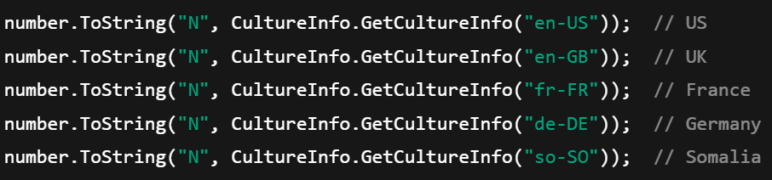
Example

Slide 30
Displaying Numeric Values
The Text property of a control only accepts string literals
To display a number in a TextBox or Label control requires you to convert a numeric data to string type
In
all variables work with the ToString method to convert the value of
the variables to strings:
You call the ToString method using the following general format: variableName.ToString()
decimal grossPay = 1550.0m;
grossPayLabel.Text = grossPay.ToString();
int myNumber = 123;
MessageBox.Show(myNumber.ToString());
Another option is “implicit string conversion with the + operator”:
int idNumber = 1044;
string output = "Your ID number is " + idNumber;

Slide 31
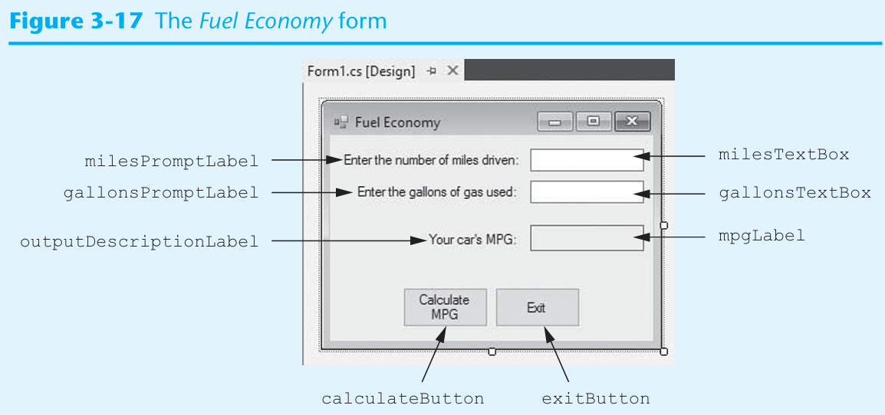
Home Assignment

Slide 32
3.6 Formatting Numbers with the ToString Method
The ToString method can optionally format a number to appear in a specific way
The following table lists the Format Strings and how they work with sample outputs
Format String | Description | Number | ToString() | Result
"N" or "n" | Number format | 12.3 | ToString("n3") | 12.300
"F" or "f" | Fixed-point scientific format | 123456.0 | ToString("f2") | 123456.00
"E" or "e" | Exponential scientific format | 123456.0 | ToString("e3") | 1.235e+005
"C" or "c" | Currency format | Negative 1234567.8 | ToString("C") | ($1,234,567.80)
"P" or "p" | Percentage format | .234 | ToString("P") | 23.40%

Slide 33
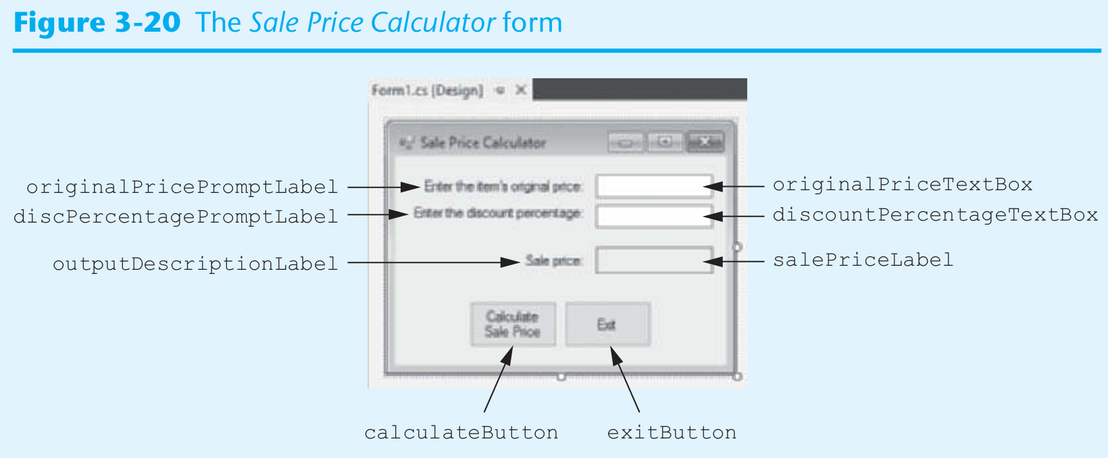
Home Assignment

Slide 34
3.7 Simple Exception Handling
An exception is an unexpected error that happens while a program is running ,Exceptions = runtime errors. Example errors:
  Dividing by zero
  Trying to open a file that does not exist
  Invalid user input
If an exception is not handled by the program, the program will abruptly halt
What is exception handling? Exception handling is writing special code that catches errors and tells the program what to do instead of crashing.
This code is called an exception handler.
This allows you to write code that responds to exceptions. Such code is known as an exception handler.

Slide 35
Handling Exceptions with try-catch
General format of the try-catch statement:
try
{
statement;
statement;
etc.
}
catch
{
statement;
statement;
etc.
}
The try block is where you place the statements that can cause an exception
The catch block is where you place statements that respond to the exception when it happens

Slide 36
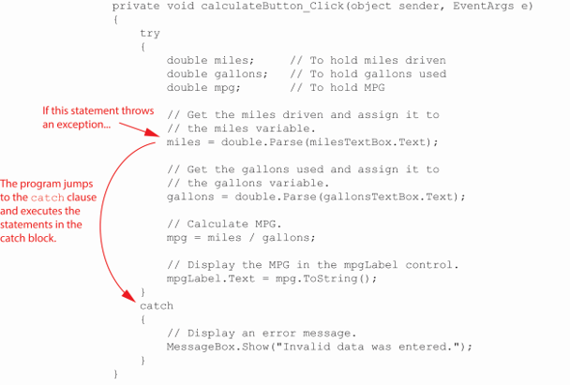
Throwing an Exception
In the following example, if the user enters nonnumeric data into the milesText control, an exception is thrown.
Notes:
Line 1. private void calculate button underscore click left parenthesis object sender comma event args e right parenthesis. Line 2. Left brace. Line 3. Indented. Try. Line 4. Indented. Left brace. Line 5. Indented twice. Double miles semicolon. Line 6. Indented twice. Double gallons semicolon. Line 7. Indented twice. Double m p g semicolon. Line 8. Blank. Line 9. Indented twice. Forward slash forward slash get the miles driven and assign it to. Line 10. Indented twice. Forward slash forward slash the miles variable. Line 11. Indented twice. Miles equals double period parse left parenthesis miles text box period text right parenthesis semicolon. Line 12. Blank. Line 13. Indented twice. Forward slash forward slash get the gallons used and assign it to. Line 14. Indented twice. Forward slash forward slash the gallons variable. Line 15. Indented twice. gallons equals double period parse left parenthesis gallons text box period text right parenthesis semicolon. Line 16. Blank.Line 17. Indented twice. Forward slash forward slash calculate m p g. Line 18. Indented twice. M p g equals miles forward slash gallons semicolon. Line 19. Blank.Line 20. Indented twice. Forward slash forward slash display the m p g in the m p g label control. Line 21. Indented twice. M p g label period text equals m p g period to string left parenthesis right parenthesis semicolon. Line 22. Indented. Left brace. Line 23. Indented. Catch. Line 24. Indented. Left brace. Line 25. Indented twice. Forward slash forward slash display an error message. Line 26. Indented twice. Message box period show left parenthesis double quote invalid data was entered. Double quote right parenthesis semicolon. Line 27. Indented. Right brace. Line 28. Right brace. An arrow labeled if this statement throws an exception points to line 11. Another arrow labeled The program jumps to the catch clause and executes the statements in the catch block points from line 11 to line 23.

Slide 37
What is different Throwing, Catching
Throwing = raising the error (problem occurs).
Catching = handling the error (deciding what to do about it).
Real-Life Examples
ATM Machine
                You enter your PIN incorrectly three times.
Throwing: The ATM raises an error ("Invalid PIN").
Catching: Instead of shutting down, the ATM shows a friendly message:
“Invalid PIN, please try again.”
Car Driving
Your car runs out of fuel while driving.
Throwing: The car has a problem (fuel is empty).
Catching: The dashboard shows a warning light instead of letting the engine suddenly die without warning.

Slide 38
Displaying an Exception’s Default Message
Every exception (error) in C# is an object
That object has a property called Message which stores a description of the error.
The Exception object's Message property holds the exception's default error message.
You can use the following format to display the exception’s error message:
try
{
statement;
statement;
etc.
}
catch (Exception ex)
{
MessageBox.Show(ex.Message);
}

Slide 39
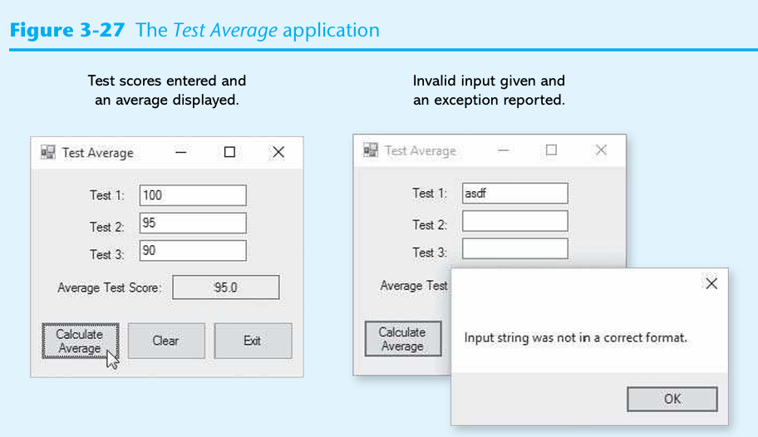
Practice with class

Slide 40
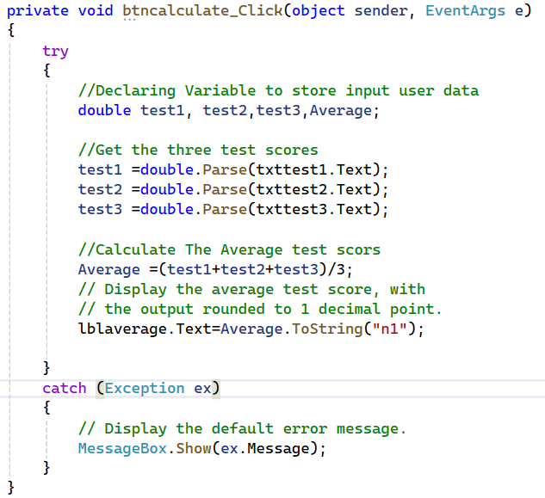
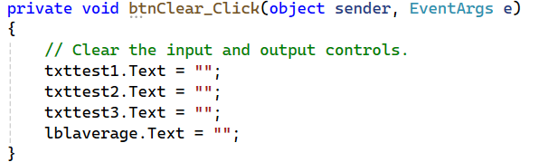
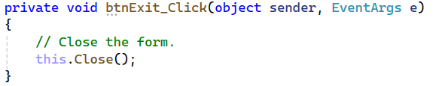
Solution The Code

Slide 41
3.8 Using Named Constants
A named constant is a name that represents a value that cannot be changed during the program’s execution
In a constant can be declared by const keyword:
const double INTEREST_RATE = 0.129;
Writing the name of a constant in uppercase letters is traditional in many programming languages but is not a requirement.

Slide 42
3.9 Declaring Variables as Fields
A field is a variable that is declared at the class level
It is declared inside the class, but not inside of any method
A field’s scope is the entire class
In the following FieldDemo application, the name variable is a field that is declared in the Form1 class
The name field is created in memory when the Form1 form is created

Slide 43
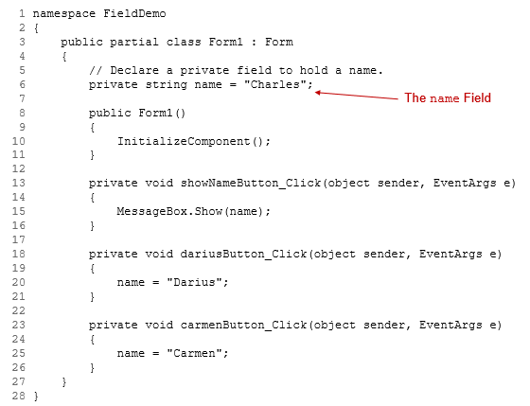
The FieldDemo Application
Notes:
The computer code has 28 lines. Line 1. Name space Field Demo. Line 2. left brace. Line 3, indented once. public partial class Form1 colon Form. Line 4, indented once. left brace. Line 5, indented twice. forward slash forward slash Declare a private field to hold a name period. Line 6, indented twice. private string name equals sign double quote Charles double quote semicolon. Line 7. blank. Line 8, indented twice. public Form1 left parenthesis right parenthesis. Line 9, indented twice. left brace. Line 10, indented thrice. Initialize Component left parenthesis right parenthesis semicolon. Line 11, indented twice. right brace. Line 12. blank. Line 13, indented twice. private void show Name Button underscore Click left parenthesis object sender comma Event A r g s e right parenthesis. Line 14, indented twice. left brace. Line 15, indented thrice. Message Box period Show left parenthesis name right parenthesis semicolon. Line 16, indented twice. right brace. Line 17. blank. Line 18, indented twice. private void darius Button underscore Click left parenthesis object sender comma Event A r g s e right parenthesis. Line 19, left brace. Line 20, indented thrice. name equals sign double quote Darius double quote semicolon. Line 21, indented twice. right brace. Line 23. blank. Line 23, indented twice. private void carmen Button underscore Click left parenthesis object sender comma Event A r g s e right parenthesis. Line 24, indented twice. left brace. Line 25, indented thrice. name equals sign double quote Carmen double quote semicolon. Line 26, indented twice. right brace. Line 27, indented once. right brace. Line 28. right brace. Line 6 in the computer code is labeled, the name field.

Slide 44
3.10 Using the Math Class
The .NET Math class provides several methods for performing complex mathematical calculations
  Math.Sqrt(x): returns the square root of x (a double).
  Math.Pow(x, y): returns the value of x raised to the power of y. Both x and y are double.
  Math.Max(x, y): Returns the greater of the two values x and y
  Math.Min(x, y):Returns the lesser of the two values x and y.
  Math.Round(x) :Returns the value of x (a double or a decimal) rounded to the nearest integer.
There are two predefined constants:
  Math.PI: represents the ratio of the circumference of a circle to its diameter.
  Math.E: represents the natural logarithmic base

Slide 45
3.11 More G U I Details – Tab Order
When an application is running, one of the form’s controls always has the focus
Focus means a control receives the user’s keyboard input
  When a button has the focus, pressing the Enter key can execute the button’s Click event handler
The order in which controls receive the focus is called the tab order
  When the user presses the tab key to select controls, the program will follow the tab order
The TabIndex property contains a numeric value indicating the control’s position in the tab order
  The value starts with 0. The index of first control is 0, the nth
  control is

Slide 46
Tab Order (1 of 2)
To set the tab order of a control, click Tab Order on the View menu. This activates the tab-order selection mode on the form.
  Simply click the controls with the mouse in the order you want.
Notice that Label controls do not accept input from the keyboard. They cannot receive focus.
  Their TabIndex values are irrelevant

Slide 47
Tab Order (2 of 2)
You can use the Focus method to change the focus using the following syntax:
ControlName.Focus();
The following changes the focus to nameTextBox when the user clicks the Clear button:
private void clearButton_Click(object sender, EventArgs e)
{
nameTextBox.Focus();
}

Slide 48
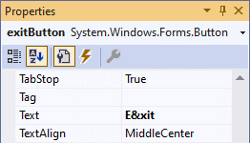
Assign Keyboard Access Key to Buttons
An access key (or mnemonic) is a key that is pressed in combination with the Alt key to quickly access a control
You can assign an access key to a button’s Text property by adding
an ampersand (&) before a letter
The user can use the keystrokes Alt + X or Alt + x.
  An access key does not distinguish between uppercase and lowercase

Slide 49
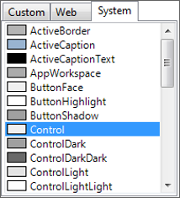
Setting Colors
Forms and most controls have a BackColor property
Controls that can display Text also have a ForeColor property
These color-related properties support a drop-down list of colors
The list has tree tabs:
  Custom: display a color palette
  Web: list colors displayed with consistency in Web browsers
  System: list colors defined in current Windows
You can set colors in color
  The .NET Framework provides numerous values that represent colors
messageLabel.BackColor = Color.Black;
messageLabel.ForeColor = Color.Yellow;

Slide 50
Background Images for Forms (1 of 2)
A Form has a property named BackgroundImage that is similar to the Image property of a PictureBox.
  Simply import an image to the Select Resource window
A Form also has a BackgroundImageLayout property that is similar to the SizeMode property of a PictureBox.
  Choose from one of the following options

Slide 51
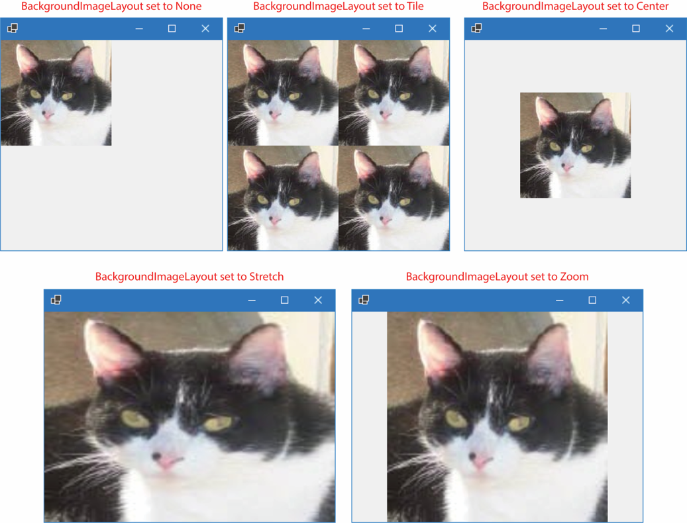
Background Images for Forms (2 of 2)
Notes:
In the first configuration, Background image layout set to none, the image is in the upper left corner of the form 1 dialog box. The second configuration, Background image layout set to tile, duplicates the image four times to fill the dialog box. In the third configuration, Background image layout set to center, the image is centered in the dialog box. The fourth configuration, Background image layout set to stretch, has the image enlarged and stretched to fill the dialog box. In the fifth configuration, Background image layout set to zoom, the image is enlarged but not stretched, so that the top and bottom sides of the image reach the top and bottom sides of the dialog box, while the left and right sides of the image don’t reach the sides of the dialog box.

Slide 52
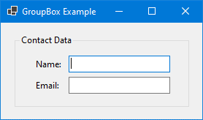
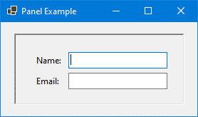
GroupBoxes versus Panels
A GroupBox control is a container with a thin border and an optional title that can hold other controls
A Panel control is also a container that can hold other controls
There are several primary differences between a Panel and GroupBox:
  A panel cannot display a title and does not have a Text property, but a GroupBox supports these two properties.
  A panel’s border can be specified by its BorderStyle property, while the GroupBox cannot be

Slide 53
3.12 Using the Debugger to Locate Logic Errors
A logic error is a mistake that does not prevent an application from running, but causes the application to produce incorrect results.
  Mathematical errors
  Assigning a value to the wrong variable
  Assigning the wrong value to a variable
  etc.
Finding and fixing a logic error usually requires a bit of detective work.
Visual Studio provides debugging tools that make locating logic errors easier.

Slide 54
Breakpoints (1 of 2)
A breakpoint is a line you select in your source code.
When the application is running and it reaches a breakpoint, the application pauses and enters break mode.
While the application is paused, you may examine variable contents and the values stored in certain control properties.

Slide 55
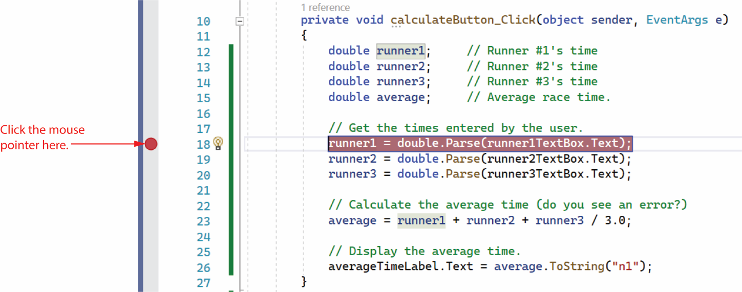
Breakpoints (2 of 2)
Notes:
There is a red dot on the left side of the form, indicating a breakpoint. The line of code next to the red dot is highlighted. An arrow points to the breakpoint and text reads, click the mouse pointer here.

Slide 56
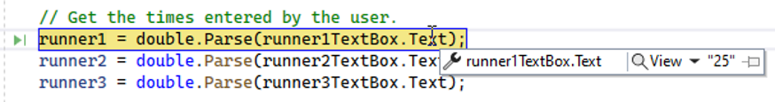
Break Mode
In Break mode, to examine the contents of a variable or control property, hover the cursor over the variable or the property's name in the Code editor.

Slide 58
The Locals and Watch Windows
The Locals window displays a list of all the variables in the current procedure. The current value and the data type of each variable are also displayed.
The Watch window allows you to add the names of variables you want to watch. This window displays only the variables you have added. Visual Studio lets you open multiple Watch windows.
You can open any of these windows by clicking Debug on the menu bar, then selecting Windows, and then selecting the window that you want to open.

Slide 59
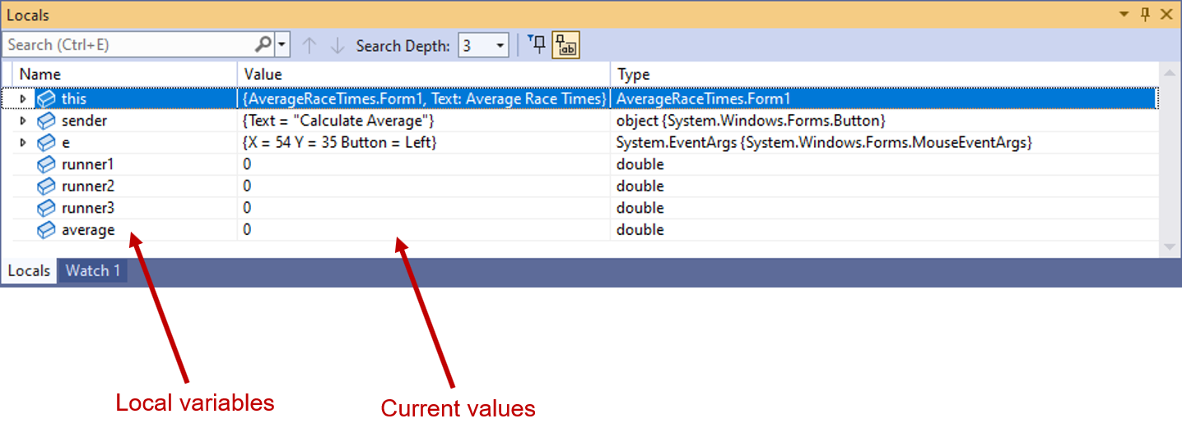
The Locals Window
Notes:
The window displays the following contents. Search bar, drop down list for search depth, number 3 is selected, and pin option. The main section displays name, value, and type in a tabular form. The table is as follows. The table has seven rows and three columns. The column headings from left to right are as follows. Name, Value, and type. The row entries are as follows. Row 1. This, left parenthesis average race times dot form 1, text comma average race times, average race times dot Form 1. Row 2. Sender, left brace text equals double quote calculate average double quote right brace, object left brace system dot windows dot forms dot mouse event A r g s right brace. Row 3. e, left brace, X equals 54 Y equals 35 button = left right brace, system dot event A r g s left brace system dot windows dot forms dot mouse Event A r g s right brace. Row 4. Runner 1, 0, double. Row 5. Runner 2, 0, double. Row 6. Runner 3, 0, double. Row 7. Average, 0, double. The first column is labeled, local variable and the second column is labeled, current values.

Slide 60
Single-Stepping (1 of 2)
Visual Studio allows you to single-step through an application’s code once its execution has been paused by a breakpoint.
This means that the application's statements execute one at a time, under your control.
After each statement executes, you can examine variable and property values.
This process allows you to identify the line or lines of code causing the error.

Slide 61
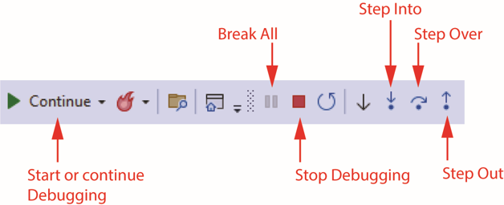
Single-Stepping (2 of 2)
To single-step, do any of the following:
  Press F11 on the keyboard, or
  Click the Step Into command on the toolbar, or
  Click Debug on the menu bar, and then select Step Into from the Debug menu

Slide 62
Copyright
This work is protected by United States copyright laws and is provided solely for the use of instructors in teaching their courses and assessing student learning. Dissemination or sale of any part of this work (including on the World Wide Web) will destroy the integrity of the work and is not permitted. The work and materials from it should never be made available to students except by instructors using the accompanying text in their classes. All recipients of this work are expected to abide by these restrictions and to honor the intended pedagogical purposes and the needs of other instructors who rely on these materials.

